Slide 1

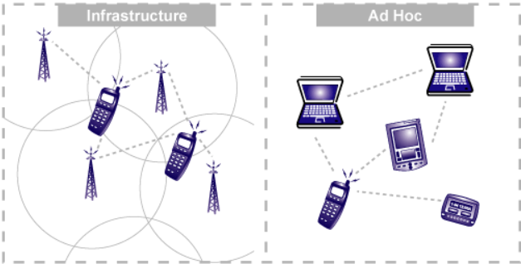








Wireless Networks
Dimitrios Chrisovalantis Zoumpakis
Abstract
This poster briefly explores wireless networks from their inception to modern 5G technology. It discusses their role in computer engineering, including key industry players and research trends such as cybersecurity and energy efficiency. Practical applications and job prospects are also highlighted, along with fascinating facts about wireless networks' historical significance.
Job and career prospects
- The future for wireless network engineers, IoT specialists, and cybersecurity experts looks bright with the rise of 5G and IoT.
- Vinton G. Cerf's recognition of IP's importance reinforces this outlook.
- Trends like cloud adoption and AI integration are driving industry hires, according to TechTarget.
- Skilled professionals can expect ample opportunities in this evolving field.
Background
A network typically consists of interconnected computers using the same protocol to communicate.
- LAN (Local Area Network) is a common type, connecting computers over short distances for data sharing.
- Understanding terms like IP address (unique numbers assigned to devices for communication) and node (connection points in a network) is essential.
- These concepts establish the groundwork for wireless networks.
WN & Computer Engineering
- Computer engineering plays a vital role in developing wireless networks, including creating devices like routers and switches.
- It also involves establishing key protocols and standards such as WiFi, Bluetooth, and 5G.
- Leading industry players like CISCO, Qualcomm, Intel, and Broadcom drive innovation in wireless technology.
- Their contributions are instrumental in advancing wireless networks.
Interesting facts
- Guglielmo Marconi transmitted the first wireless signal in 1895, spanning 2000 miles.
- The term "Wi-Fi" originated from "High-Fidelity" for simplicity, referring to the IEEE 802.11b Direct Sequence standard.
Introduction
A wireless network operates through wireless data connections between network nodes, relying on radio frequency (RF) technology to establish communication. Two basic modes are infrastructure mode, requiring physical support like routers or towers, and Ad-hoc mode, where devices communicate directly without a central access point. In Ad-hoc networks, devices determine the best path for data transmission. For instance, a group of friends using walkie-talkies in a park illustrates Ad-hoc communication, eliminating the need for a central relay station.
Conclusion
Wireless networks, evolving since the late 1970s, have revolutionized communication. They are integral to computer engineering, led by major players like CISCO and Qualcomm. Academia fuels innovation, with Ericsson and Huawei at the forefront of practical applications. Job prospects are strong, especially in IoT and cybersecurity. Intriguing facts, like Marconi's first transmission and the origin of "Wi-Fi," highlight the rich history and ongoing innovation in wireless networking.
WN as an Applied field
- Wireless networks are pivotal for sensor technology, used in monitoring environmental factors like water quality and forest fires.
- They also aid in tracking, facilitating fault detection across industries and military operations such as tracking enemy troop movements.
- Key players like Ericsson and Huawei lead in 5G technology evolution, followed by Nokia, Samsung, and ZTE.
Research Field & Academia
- Wireless network research focuses on reducing energy consumption and enhancing efficiency.
- Emphasis is placed on network security to counter growing threats.
- Academia contributes through active research and specialized degree programs.
- Future trends aim to develop disruptive 6G technologies for enhanced performance.
References
IBM
PCMAG
IEEE
CISCO

